Slide 1

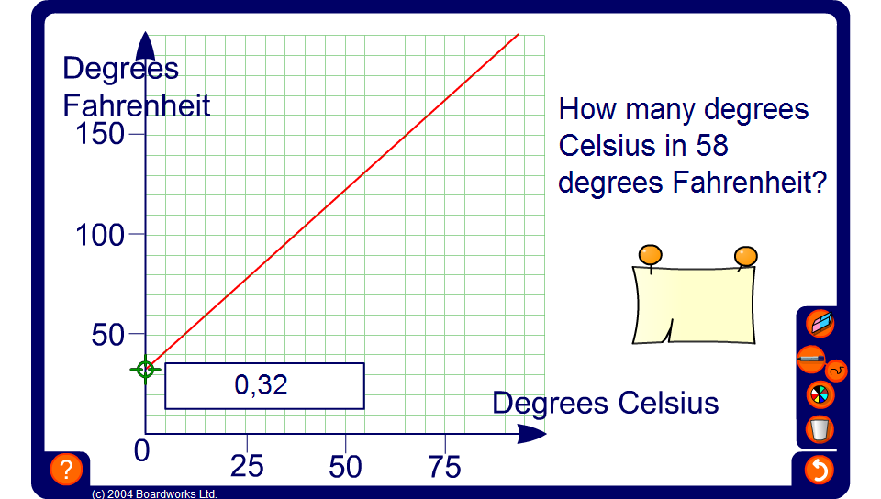


Conversion graphs – temperature
Notes:
Point out that most conversion graphs are straight lines passing through the origin and ask pupils what this means. Establish that it means that the two quantities are directly proportional and explain what this means.
The conversion graph on the board is an example of a conversion graph in which the units are not directly proportional. This is because 0 degrees Celsius equals 32 degrees Fahrenheit and thus the line passes through the point (0, 32).
Point out that different scales have been used for the horizontal and vertical axes. Ask what one square along the horizontal axis represents and what one square along the vertical axis represents.
Point out, too, that the axes must always be labelled and the graph must always have a suitable title.
Drag the point along the line to demonstrate a variety of Fahrenheit to Celsius conversions.
Drag the point on the graph to find approximate answers to the required conversions.

